Slide 1
Introduction to Virtual Machine
June 04 2021
Dane Payusan

Slide 2

What is Virtual Machine?
Virtual Machine(VM)
A virtual representation, or emulation of a physical computer. They are often referred to as a guest while the physical machine they run on is referred to as the host
Virtualization makes it possible to create multiple VM with their own operating system(OS) and applications on single physical machine

Slide 3
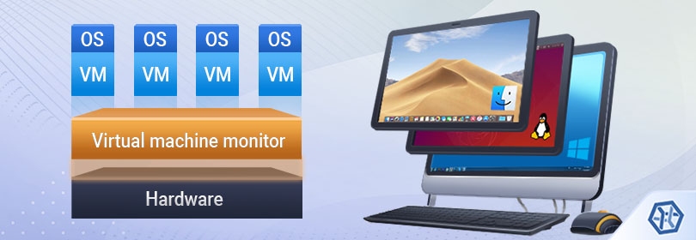
Virtual Machine cannot interact directly with physical computer
Hypervisor is needed to coordinate between and physical hardware
This technology can go by many names
Virtual server
Virtual server instance (VSI)
Virtual private server (VPS)

Slide 4
Hypervisor
A lightweight software layer that allocates physical computing resources to each VM
processors
memory
storage
Keeps each VM separated and don’t interfere with each other
Types of Hypervisor
Type 1/Native
- Runs directly on physical hardware
Type 2/Hosted
- Runs as an application within a host OS

Slide 5
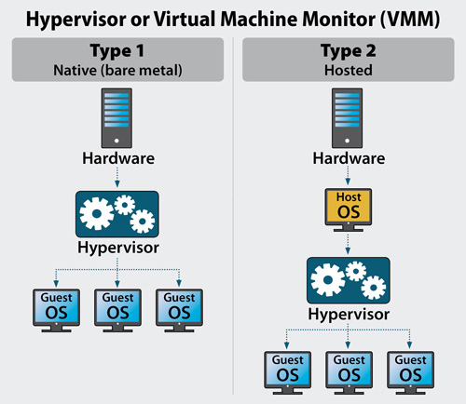

Slide 6
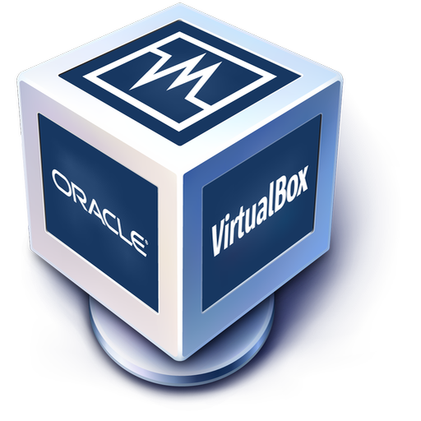
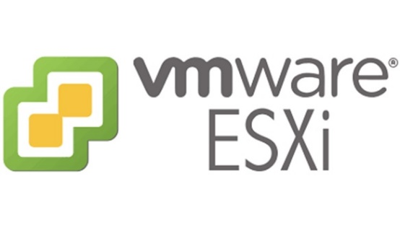
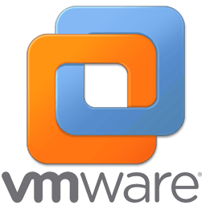
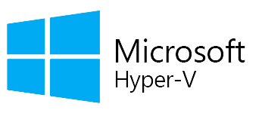
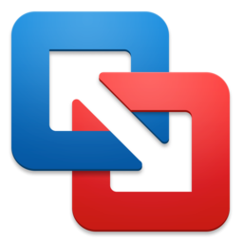
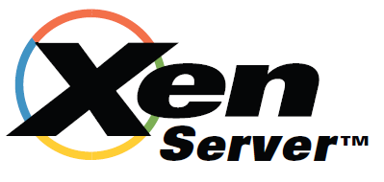
Example
Type 1
ESXi hypervisor
VSphere hypervisor
Hyper-V
Citrix XenServer
Type 2
VMware Fusion
Workstation
VirtualBox

Slide 7
Virtualization
Uses software to create an abstraction layer over computer hardware that allows hardware elements to be divided into multiple VMs
Enables more efficient utilization of physical computer hardware
Standard practice in enterprise IT architecture
Also drives cloud computing economics

Slide 8
Types of Virtualization
Desktop virtualization
Network virtualization
Storage virtualization
Data virtualization
Application virtualization
Data center virtualization
CPU virtualization
GPU virtualization
Linux virtualization
Cloud virtualization

Slide 9

Benefits of Virtualization
Resource efficiency
Easier management
Minimal downtime
Faster provisioning
Slash your IT expenses

Slide 10
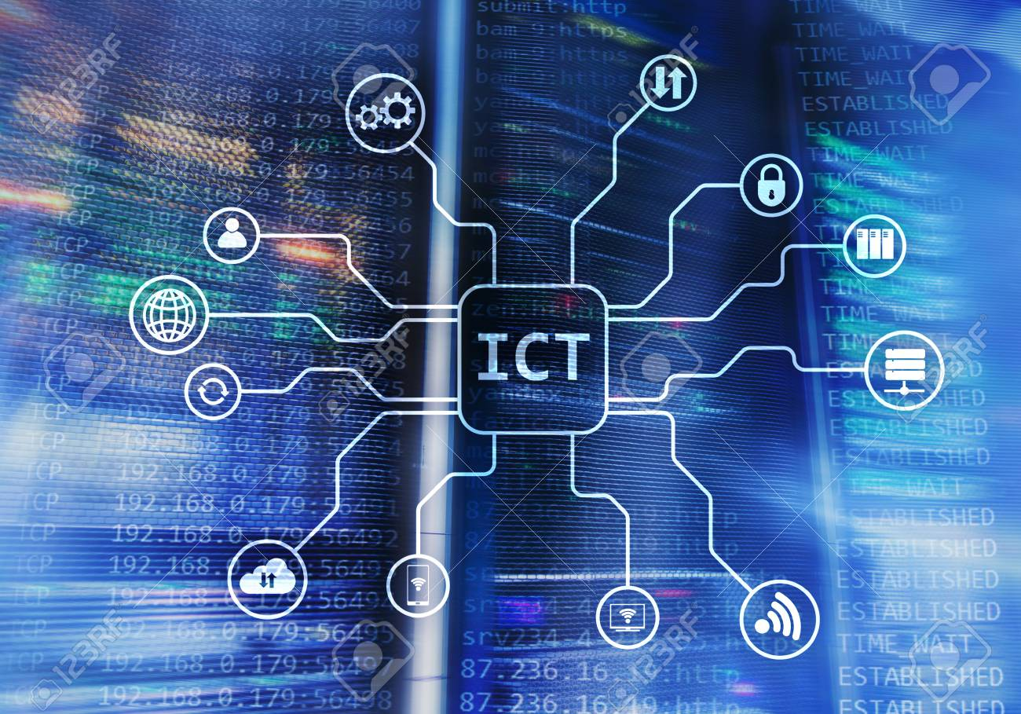
Use cases for VMs
Cloud computing
Support DevOps
Test new operating system
Investigate malware
Run incompatible software
Browse securely

Slide 11
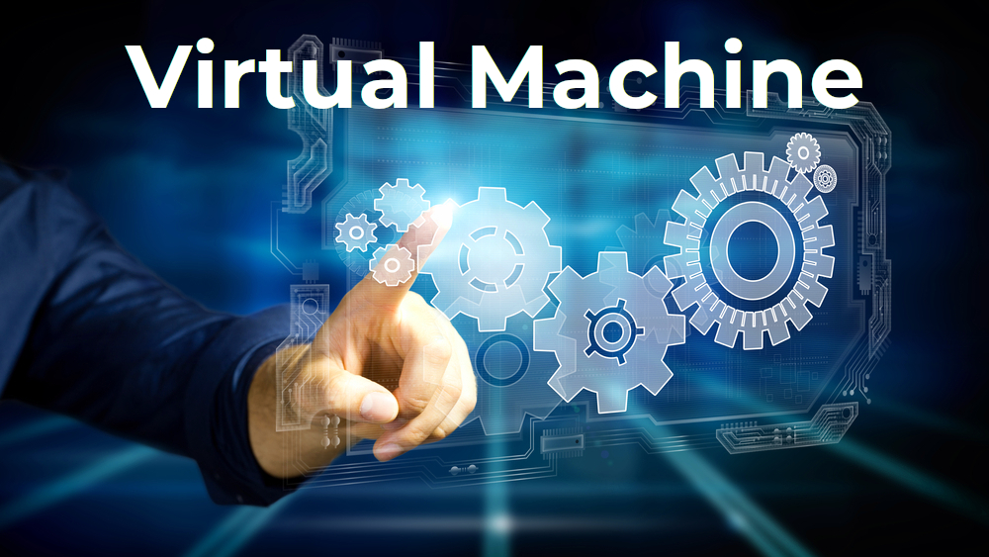
Types of VMs
Windows virtual machines
Android virtual machines
Mac virtual machines
iOS virtual machines
Java virtual machines
Python virtual machines
Linux virtual machines
VMware virtual machines
Ubuntu virtual machines

Slide 12
Reference
https://www.ibm.com/in-en/cloud/learn/virtual-machines
https://www.ibm.com/cloud/learn/hypervisors
https://www.ibm.com/cloud/learn/virtualization-a-complete-guide
https://www.ibm.com/cloud/blog/5-benefits-of-virtualization

Slide 13


